Slide 1
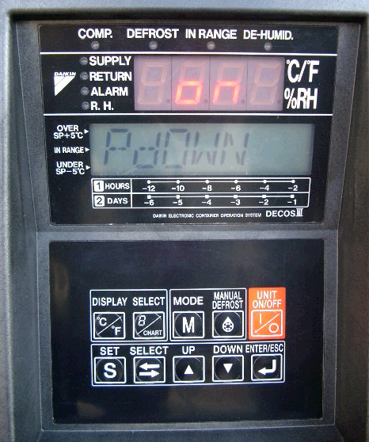
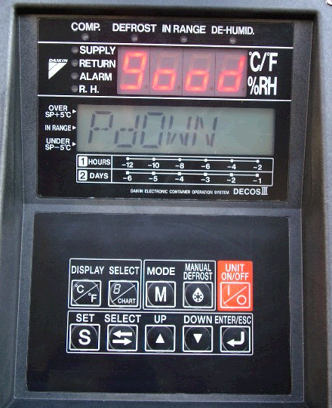
Replacement of Dryer
①Conduct the automatic pump down.
Pump down mode
Pump down completed
Press □ key
to start pump
down.
Press the M key twice to select the pump down mode,
then, the LCD indicates “PdOWN”.
Select “on” by using △ key or ▽ key.

